Slide 1
Attacks
Types of Attacks
Passive Attacks
Active Attacks
Notes:
A cyber attack is any type of offensive action that targets computer information systems, infrastructures, computer networks or personal computer devices, using various methods to steal, alter or destroy data or information systems.
‹#›

Slide 2
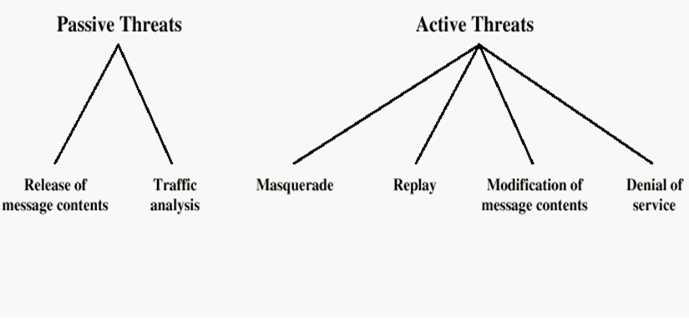
Attacks

Slide 3
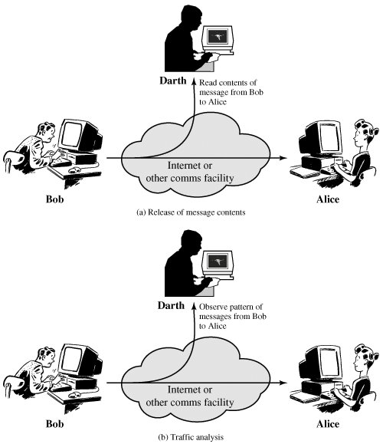
Passive Attacks
Notes:
* Traffic analysis is enclosed in eavesdropping
‹#›

Slide 4
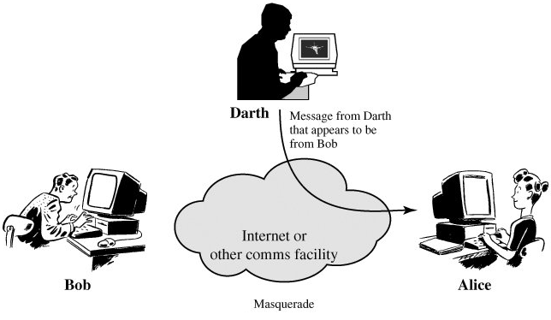
Masquerade
Masquerade takes place when one entity pretends
to be an another entity.
* These images are copied from the textbook (Cryptography and Network Security, by William Stallings).
‹#›
Notes:
Masquerade (masking, disguise)
A masquerade may be attempted through the use of stolen logon IDs and passwords (Keylogger)
Weak authentication provides one of the easiest points of entry for a masquerade
‹#›

Slide 5
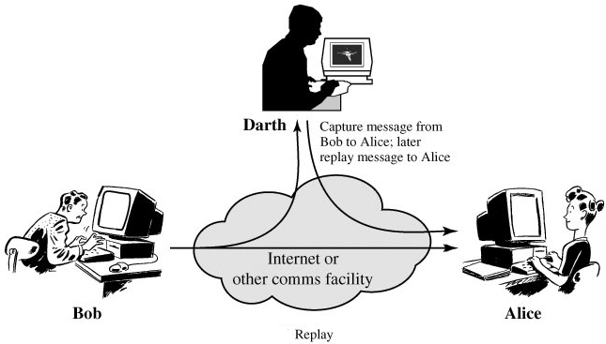
Replay
Involves the passive capture of a data unit and its
subsequent retransmission to produce an unauthorized effect.
‹#›
Notes:
Technique that could be used to avoid a replay attack is by creating random session keys which are time bound and process bound.
The other popular technique is to use one-time passwords for each request. This method of prevention is very often used for banking operations.
‹#›

Slide 6
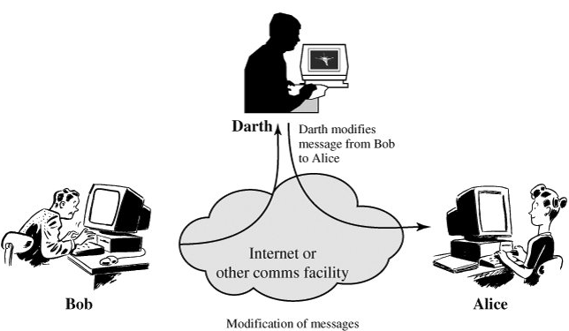
Modification of message
Means that some portion of a legitimate message is altered.
‹#›
Notes:
‹#›

Slide 7
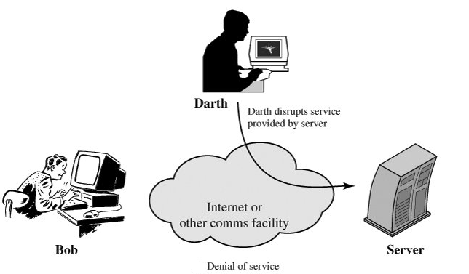
Denial of service
A denial-of-service (DoS) is any type of attack where the attackers (hackers) attempt to prevent legitimate users from accessing the service.
‹#›
Notes:
‹#›

Slide 8
Anatomy of an attack
Attacker
Some one outside your network perimeter who is trying to break in
Regular user has an inside view, so overwhelming majority originate from inside
Collecting information
Probing the network
Launching an attack

Slide 9
Collecting information
XYZ is the user that wants to attack your network.
Question: Where to start?
In order to get it he has to do some investigative work about your network.
The first thing it can do is to run the “whois” query.
Live and authoritative

Slide 10
Whois
Query to the interNIC.
It maintains the publicly accessible database of all registered domains
Can be searched with simple query “whois domainname”
“Whois pugc.edu.pk”

Slide 11
The organizational domain name
The organizational location
The organization’s administrative contact
The phone no and fax number for the administrator
A valid subnet address within the organization

Slide 12
Organization domain name
It is important because anyone can use it to collect further information
Any host associated with this name will be an extra information
www.pugc.edu.pk
mail.pugc.eud.pk
Now this host will be used as keyword to use when forming future queries

Slide 13
Physical location
Knowing physical location of Organization
Might get temp job, offer his consulting services
Once he is in, he might be granted certain level of permission to resources
Might try to backdoor into network
Wants to do dumpster diving (Who, What, When, Where and Why )
Dump sensitive information in trash
Write passwords at temp places
Not separating trash from rest for recycling

Slide 14
Admin contact
Individual responsible for maintaining network.
This is very useful for physical hacking
For example, he calls as member of help desk and asks, “hey! You have asked me to check for your certain account, there is some problems, whats ur passwd”
Dangerous for such organizations who don’t have the tendency to change passwds frequently
Email is also a valid attack for this contact, for sending spoofed mail that contains some hostile code, if email is activated then ………

Slide 15
Valid subnet mask
Last information of whois is an ip address entry for domain.
Getting an ip address of same subnet, ensures that others will be at the same place
So ip spoofing attack can be send

Slide 16
Four Categories of Attacks
Access
Modification
Denial of Service
Repudiation

Slide 17
1. Access Attack
An access attack is an attempt to gain information that the attacker is unauthorized to see.
This attack can occur wherever the information resides or may exist during transmission.
This type of attack is an attack against the confidentiality of the information.
Examples:
Snooping
Eavesdropping
Interception

Slide 18
Cont…
Confidentiality can be compromised through:
Snooping
Snooping, in a security context, is unauthorized access to another person's or company's data
Not necessarily limited to gaining access to data during its transmission
Casual observance of an e-mail that appears on another's computer screen or watching what someone else is typing
Eavesdropping
Being invisible on a public channel can be considered eavesdropping
To gain unauthorized access to information, an attacker must position himself at a location where the information of interest is likely to pass by.
Notes:
An eavesdropping attack, also known as a sniffing or snooping attack, is a theft of information as it is transmitted over a network by a computer, smartphone, or another connected device. The attack takes advantage of unsecured network communications to access data as it is being sent or received by its user.
Eavesdropping attacks can be prevented by using a personal firewall, keeping antivirus software updated, and using a virtual private network (VPN).
Avoiding public Wi-Fi networks and adopting strong passwords are other ways to prevent eavesdropping attacks.
‹#›

Slide 19
Confidentiality can be compromised through:
Interception
Unlike eavesdropping, interception is an active attack against the information
When an attacker intercepts information, he is interesting himself in the path of information and capturing it before it reaches its destination
After examining the information, the attacker may allow the information to continue to its destination or not.

Slide 20
Modification Attacks
A modification attack is an attempt to modify information that an attacker is not authorized to modify.
This type of attack is an attack against the integrity of the information.
Integrity can be compromised through:
Changes
Insertion
Deletion

Slide 21
Denial of Service Attacks
DoS attacks are attacks that deny the use of resources to legitimate users of the system, information, or capabilities.

Slide 22
Dos methods
flooding a network, thereby preventing legitimate network traffic;
disrupting a server by sending more requests than it can possibly handle, thereby preventing access to a service;
preventing a particular individual from accessing a service;
disrupting service to a specific system or person.

Slide 23
Cont…
DoS attacks can be done against the:
Information
Applications
Systems
Communications

Slide 24
Repudiation Attacks
Repudiation is an attack against the accountability of the information.
Repudiation is an attempt to give false information or to deny that a real event or transaction should have occurred.
An example of this type of attack would be a user performing a prohibited operation in a system that lacks the ability to trace.

Slide 25
Back Doors
A backdoor is a method of bypassing normal authentication or encryption in a computer system
A hardware or software-based hidden entrance to a computer system that can be used to bypass the system's security policies.
Using a known or through newly discovered access mechanism, an attacker can gain access to a system or network resource through a backdoor.

Slide 26
Cont..
There are several ways that back doors can be placed on a computer:
Opening an infected e-mail attachment (they are often combined with viruses and worms)
Exploiting a vulnerable, unpatched software application or operating system service
Active FTP server on the computer (especially one that allows "anonymous" sessions)

Slide 27
Brute Force
Also known as exhaustive key search and password attack.
Try every possible combination of options of a password.

Slide 28
Determining the Difficulty of a Brute Force Attack
The difficulty of a brute force attack depends on several factors, such as:
How long can the key be?
How many possible values can each component of the key have?
How long will it take to attempt each key?
Is there a mechanism which will lock the attacker out after a number of failed attempts?

Slide 29
Dictionary
Another form of the brute force attack.
Dictionary attack narrows the field by selecting specific accounts to attack and uses a list of commonly used passwords (the dictionary) with which to guess, instead of random combinations.

Slide 30
Spoofing
Is an attempt to gain access to a system by pretending as an authorized user.
By gaining the IP address of the trusted host and then modify the packet headers so that it appears that the packets are coming from that host.
IP spoofing
ARP spoofing
Email spoofing

Slide 31
IP Spoofing
Inserting the IP address of an authorized user into the transmission of an unauthorized user in order to gain illegal access to a computer system. Routers and other firewall implementations can be programmed to identify this discrepancy

Slide 32
ARP Poisoning
The principle of ARP spoofing is to send fake, or 'spoofed', ARPThe principle of ARP spoofing is to send fake, or 'spoofed', ARP messages to an Ethernet LAN. Generally, the aim is to associate the attacker's MAC addressThe principle of ARP spoofing is to send fake, or 'spoofed', ARP messages to an Ethernet LAN. Generally, the aim is to associate the attacker's MAC address with the IP address of another node (such as the default gateway).
Any traffic meant for that IP address would be mistakenly sent to the attacker instead. The attacker could then choose to forward the traffic to the actual default gateway (passive sniffing) or modify the data before forwarding it (man-in-the-middle attack).
The attacker could also launch a Denial of Service attack against a victim by associating a nonexistent MAC address to the IP address of the victim's default gateway.

